Slide 1
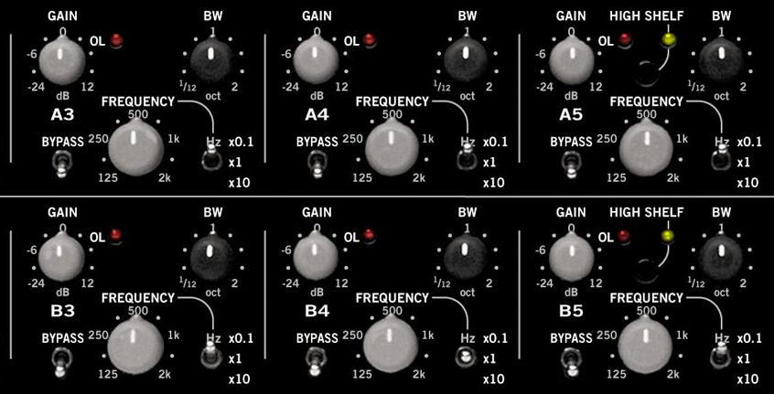
Parametric EQ

Slide 2
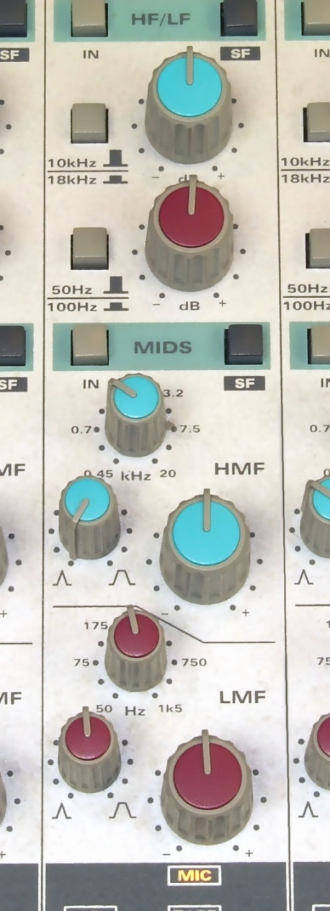
Parametric Equalisers
Used to adjust frequency content of audio signal
Flexible, but requires care
Graphic EQs only control gain for each band
Parametric EQ allows control over
Boost or cut amount
Centre frequency
Bandwidth or Q
Combination of 2nd-order IIR filters
Shelving and Peaking filters
Simplest design allowing specification of all parameters
Relatively large transition regions
May overlap when several are connected in cascade
Equaliser section from Audient ASP8024 Mixing console. Upper section has high & low shelving EQ, lower section has fully parametric EQ.
Notes:
The parametric equaliser is the ultimate as far as flexibility goes, but they require a little more care to use effectively. A single parametric EQ allows you to set not only the amount of boost or cut, but also the center frequency and the bandwidth. With experience, you can learn where to apply some boost to help an instrument cut through the mix or achieve a fuller sound. For feedback cancellation, a parametric EQ with a lot of cut (also called a notch filter) can be positioned right at the frequency where the feedback is occurring. To minimize the filter's effect on the rest of the sound, you can use a small bandwidth. You might be able to control the feedback with a graphic EQ as well, but if its bands are quite wide, you will be cutting more of the sounds that you do want to be heard. A similar application would be removing the 60 Hz hum in a recording (but you have to notch out the harmonics as well). The shelving and peaking filters are essentially specific types of parametric equalisers, at least mathematically, but most commercial products do have limits on parameters available.

Slide 3
Why parametric EQ?
Apply cut for
Feedback cancellation
Put notch at feedback frequency
Can do more precisely than graphic EQ
Small bandwidth to avoid affecting other sounds
Line noise / hum removal
Apply a cut at 50Hz or 60Hz
Also at harmonics
Apply boost to
Help instrument cut through mix
Achieve fuller sound
Use small bandwidth to minimise effect on rest of sound
Notes:
For feedback cancellation, a parametric EQ with a lot of cut (also called a notch filter) can be positioned right at the frequency where the feedback is occurring. To minimize the filter's effect on the rest of the sound, you can use a small bandwidth. You might be able to control the feedback with a graphic EQ as well, but if its bands are quite wide, you will be cutting more of the sounds that you do want to be heard. A similar application would be removing the 60 Hz hum in a recording (but you have to notch out the harmonics as well). The shelving and peaking filters are essentially specific types of parametric equalisers, at least mathematically, but most commercial products do have limits on parameters available.

Slide 4
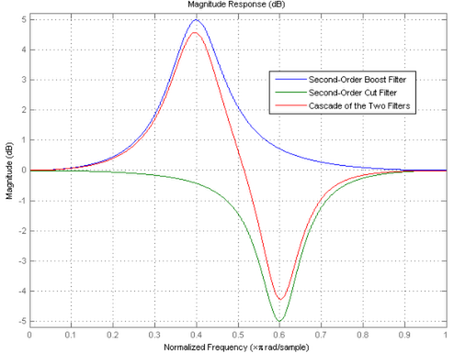
Parametric EQ plots
Combination of low shelf, peaking, high shelf filters
Connect in series
x[n]
…
y[n]
Low shelf
High shelf
Peaking
Peaking
Low and high shelves
Control cutoff frequency, gain
Typically not bandwidth
Peak filter
Control centre frequency, gain, bandwidth

Slide 5
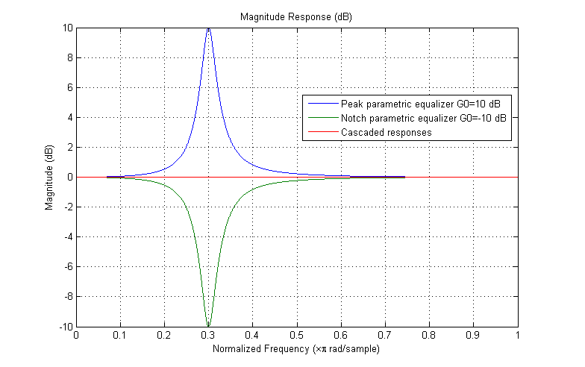
Complementary Peak and Notch Parametric Equalizers
A boost and a cut of equal amounts should cancel out their effect on the magnitude response

Slide 6

Sound examples
From http://sonicflow.sourceforge.net/sounds/
Original
Example 1
Low band corner frequency 300Hz, gain -20dB
Mid band centre frequency 800Hz, width 300Hz, gain +10dB
High band corner frequency 5000Hz, gain -20dB
Example 2
Low band corner frequency 100Hz, +10dB
Mid band centre frequency 400Hz, width 200Hz, gain -20dB
High band corner frequency 5000Hz, gain -20dB
Example 3
Low band corner frequency 200Hz, -20 dB
Mid band center frequency 400Hz, width 100Hz, gain +20dB
High band corner frequency 10000Hz, gain +20dB

